Slide 1
Statistical Analysis
Topic: Histograms
EQ: What can the shape of a histogram tell us about it?

Slide 2
Starter - Back to Back Stem Plot
8 7 4 2 0 9 8 6 5 4 4 4 3 1 6 |  | 2 3 4 5 6 7 | 3 4 4 6 6 7 8 8 9 0 0 0 1 2 5
Key:
2 | 3 means 23 km/h
Suppose that the above presented data is taken from two different roads, what conclusions could you make about the two roads?
Now suppose the above presented data was for the SAME road. Using your analysis, what might have happened on this road? Try to come up with as many different possibilities.

Slide 3
Starter Activity – Post-it note histogram
On the board there is a graph, with the x-axis going up in increments of 2, ending with 12: 0-2, 2-4, 4-6, 6-8, 8-10, 10-12
On your Post-It note, write the number of hours of sleep you get at night.
Pin your Post-It note to the graph on the board, in the appropriate column, creating a histogram
Looking at our histogram, how would we describe the shape of it? Are there any clusters of data points? Where is the median of the data?
Notes:
Teacher notes: Students are creating a post-it note histogram. You can do this survey with anything else you might want (instagram followers, favourite colours, etc...)

Slide 4
Histograms EQ: What can the shape of a histogram tell us about it?
Summary:

Slide 5
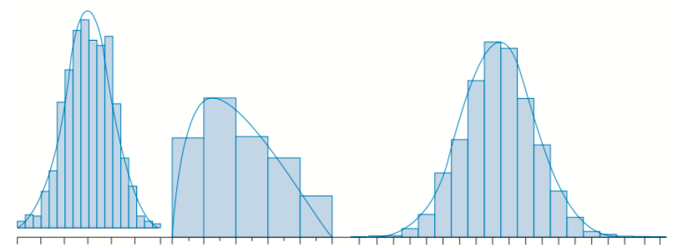
Histograms EQ: What can the shape of a histogram tell us about it?
Using a curve to represent the data:
When there is an overall pattern to the data, we can draw a smooth curve through the histogram to represent the data. Here are 3 examples:

Slide 6
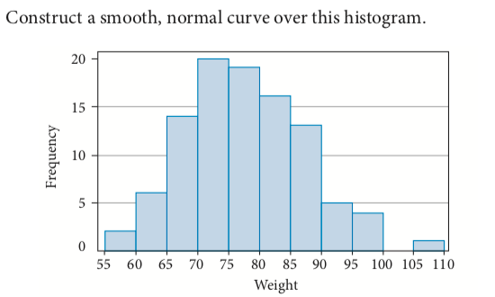
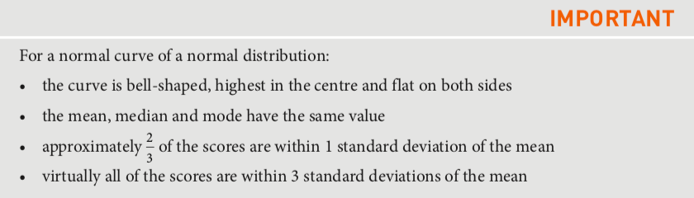
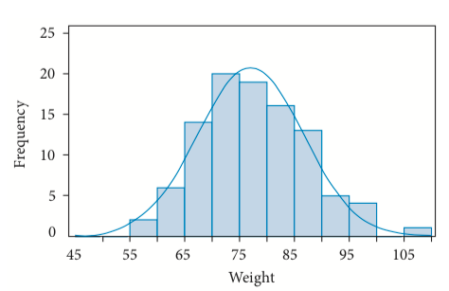
Example
Solution: Locate the center and re-arrange the heights of the column to form a smooth hump for the top of the curve. Then symmetrically flatten out the curve on both sides

Slide 7
Histograms EQ: What can the shape of a histogram tell us about it?
Complete Page 1 of your Worksheet

Slide 8
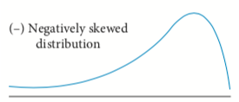
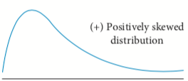
The shape of a distribution:
Skewed distributions:
Histograms are rarely the perfect bell curve of the normal shape. When data is not symmetrical
but pushed to one side, it is said to be skewed. We can identify the type of skew by looking at
the ‘tail’ of the curve.
Here the tail is on the left, so the data are
negatively skewed. This could represent marks scored by
students on an easy test. Most students scored high marks,
while relatively few scored low.
Here the tail is on the right, so the data are
positively skewed. This could represent house prices in a small country town. Lots of moderate prices and a few high prices for bigger houses or farms.

Slide 9
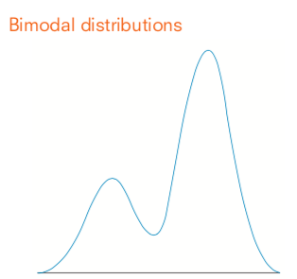
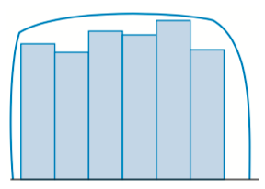
Histograms EQ: What can the shape of a histogram tell us about it?
Uniform distributions:
If we roll a normal die many times, each of the possible six numbers should appear roughly the same number of times, giving a uniform distribution. The scores are evenly distributed and its graph is close to one big rectangle.
Bimodal distributions:
If a graph or curve has two distinct peaks, it is said to have bimodal distribution. If there is only one peak, it’s called a unimodal distribution. An example of this may be a graph representing the days traffic. When might the two peaks occur?

Slide 10
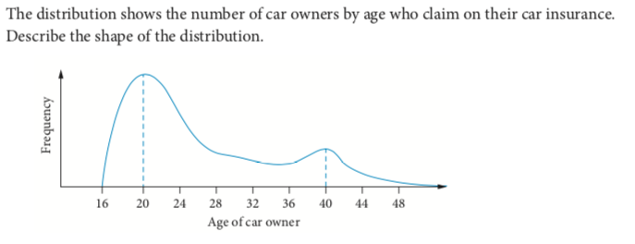
Example
The distribution is not symmetrical, so it is skewed. The tail points to the right, so it is positively skewed. There are peaks at ages 20 and 40, so the distribution is also bimodal.
Answer: The distribution is positively skewed and bimodal

Slide 11
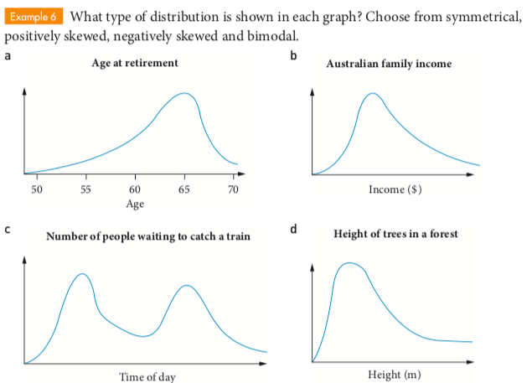
Guided Practice
*Which of these graphs are unimodal?

Slide 12
Histograms EQ: What can the shape of a histogram tell us about it?
Complete Page 2 of your Worksheet

Slide 13
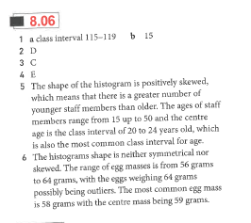
Answers

Slide 14
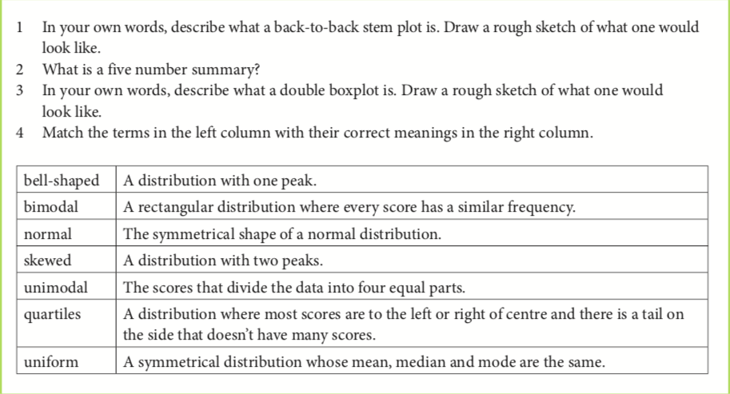
Exit Pass – Do all except #3 (we’ll get to that later)

